Slide 1
Node & Express Demo

Slide 2
INSTALLING NODE
Visit the Official Node Link to grab the installer for NodeJS:
https://nodejs.org/en/
Download and Install Node from the installer.
Check if Node was installed successfully using
node –v (It should output the version of Node currently installed)

Slide 3
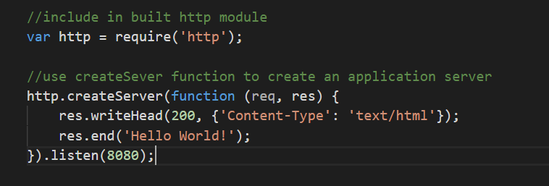
Hello World Using Node

Slide 4
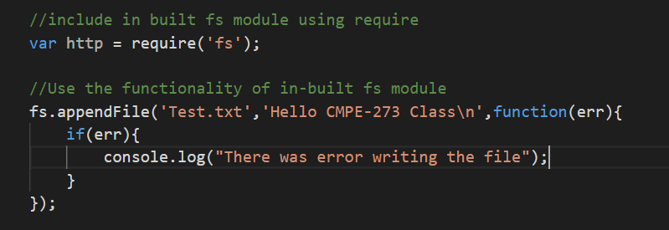
Node JS Modules – Built In Modules

Slide 5
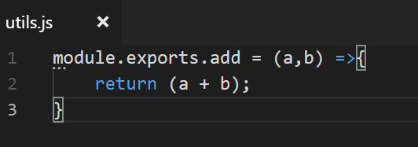
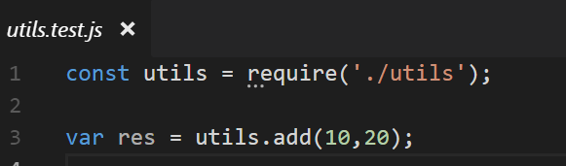
Node Modules – Requiring Custom Modules
https://nodejs.org/dist/latest-v10.x/docs/api/

Slide 6
NodeJS NPM
Package manager for Node.js packages or modules.
Create the corresponding dependencies in package.json
npm install <Module-Name> <flags>
Allowed Flag Values:
-g : Global
-s : Save
-no-save : Prevents saving to dependencies
And others

Slide 7
Express
Installing Express:
npm install express –save
Also install following important modules:
npm install body-parser –save
npm install cookie-parser –save
npm install multer --save

Slide 8
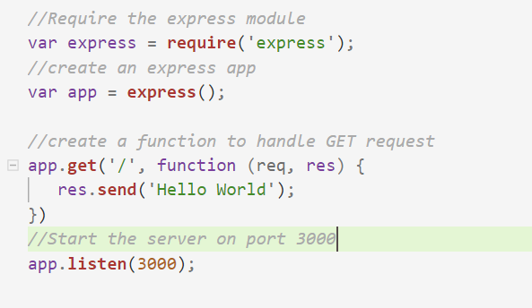
Hello World Using Express

Slide 9
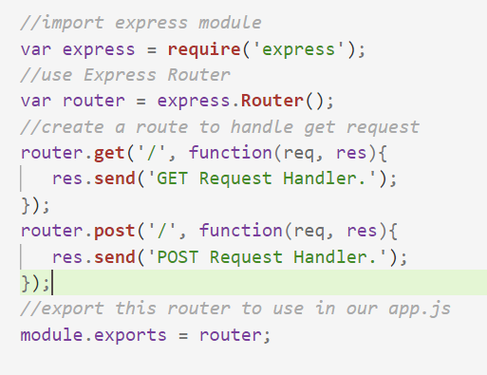
Express Router

Slide 10
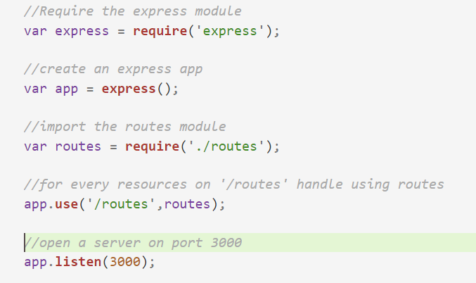
Express Router - Continued

Slide 11
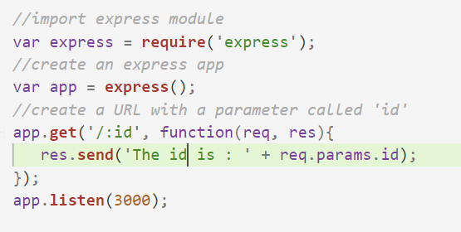
Express – URL Binding

Slide 12
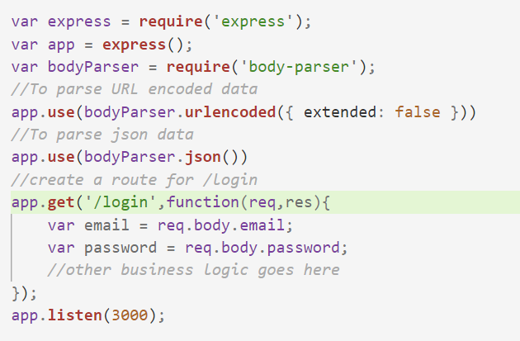
Express Middleware – Body Parser

Slide 13
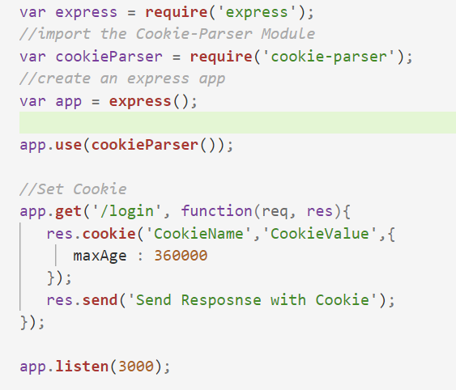
Express - Cookies

Slide 14
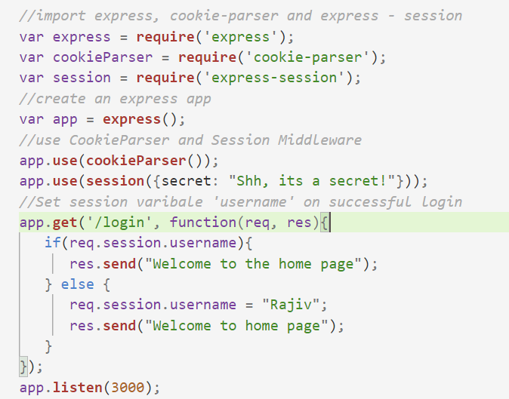
Express - Sessions

Slide 15
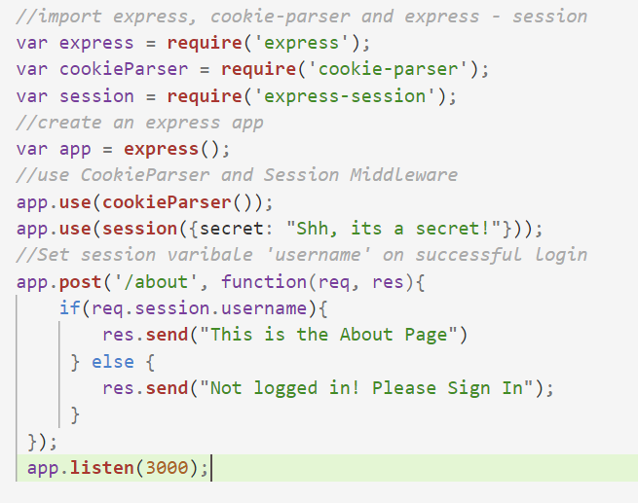
Express – Protected Route

Slide 16
Express - Templating
Popular Templating Engines:
Mustache
Handlebars
EJS
Underscore
Pug

Slide 17
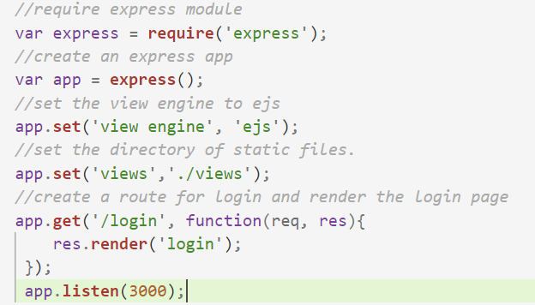
Express – Templating (Continued)

Slide 18
Node & Express – Best Practices
Initialize your project directory with npm-init.
Install dependencies with a –save flag.
Always sync your local project directory with Git Repo.
Do not add node_modules directory when pushing code to Git.
Use a proper Directory Structure for your Node Project.
Isolate every routes to their own file.

Slide 19
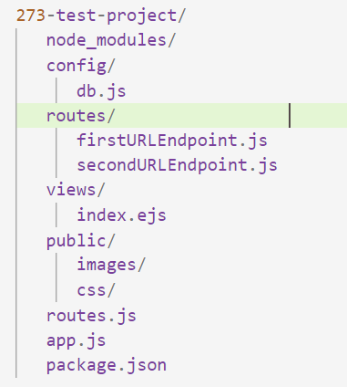
Node Project – Directory Structure

Slide 20
DEMO

